Slide 1

US SKIES STILL SAFEST WAY TO TRAVEL

Slide 2
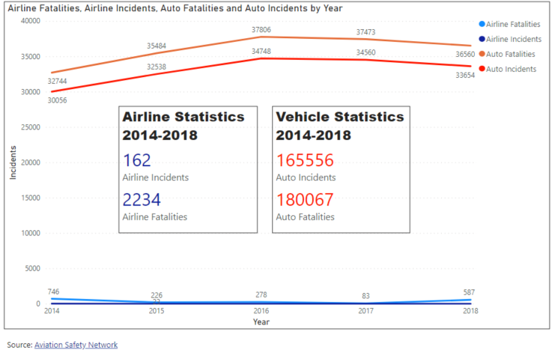
Travel by Air Much Safer Than Auto

Slide 3
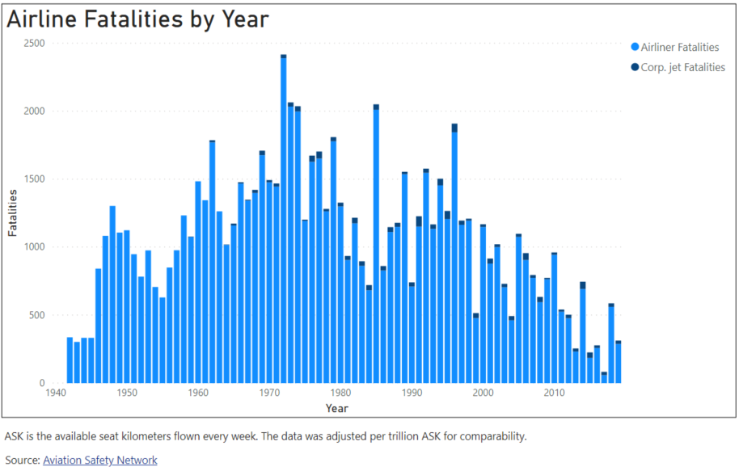
Airline Fatalities Continue Downward Trend

Slide 4
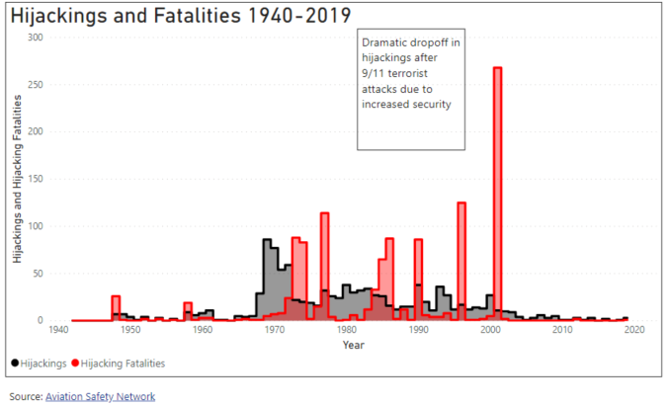
Heightened Airport Security Since 9/11

Slide 5
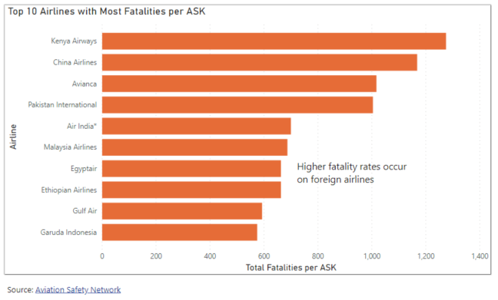
Domestic Flights Safest in the World

